Slide 1
Individual Project – Financial Dashboard
Fernando Delgado
FINANCIAL PROGRAMMING
November 14, 2021

Slide 2
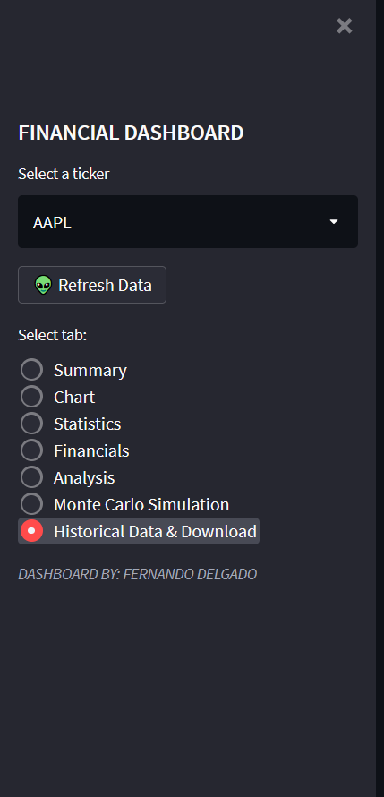
SIDEBAR
The sidebar of the Streamlit allows you to :
Select a ticker
Once the ticker is selected, refresh the data
Select the tab to view

Slide 3
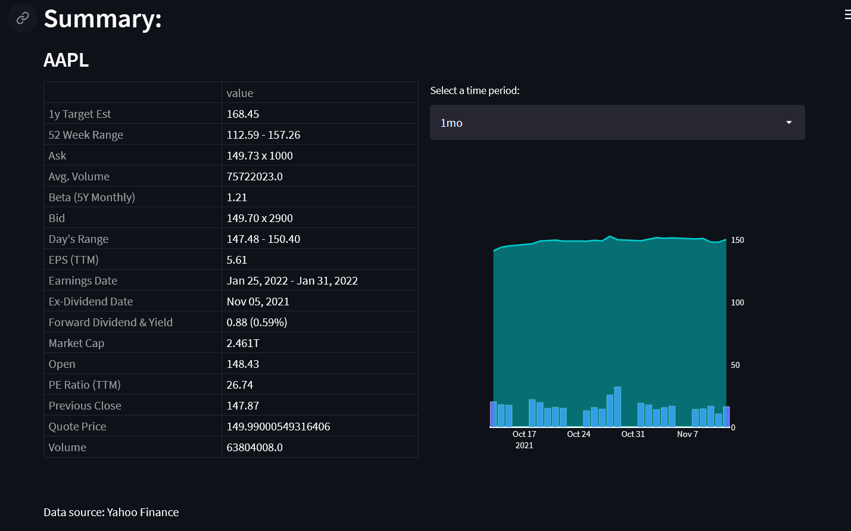
SIDEBAR
This tab shows:
A general summary of the selected ticker, as well as a graph of the stock price with the volume on the bottom.
You can select the time period for the graph. ('1mo', '3mo', '6mo', 'ytd', '1y', '3y', '5y','max’)

Slide 4
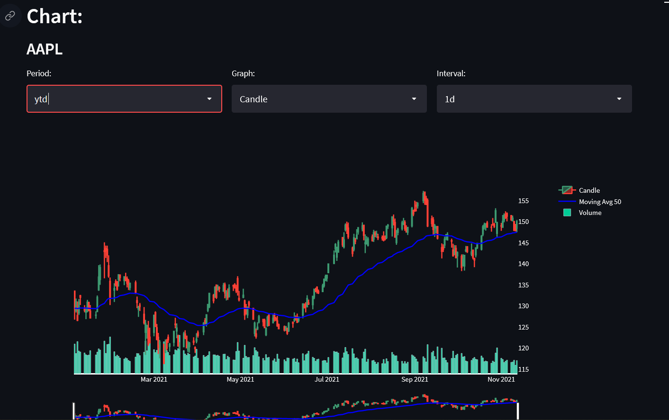
SIDEBAR
This tab shows:
A financial chart of the selected ticker that plots the close price, volume and moving average with a period of 50 days. You can select:
Period
Graph type (line/Candle)
Interval
On the bottom you can drag and drop to select a more specific date range within the selected period.

Slide 5
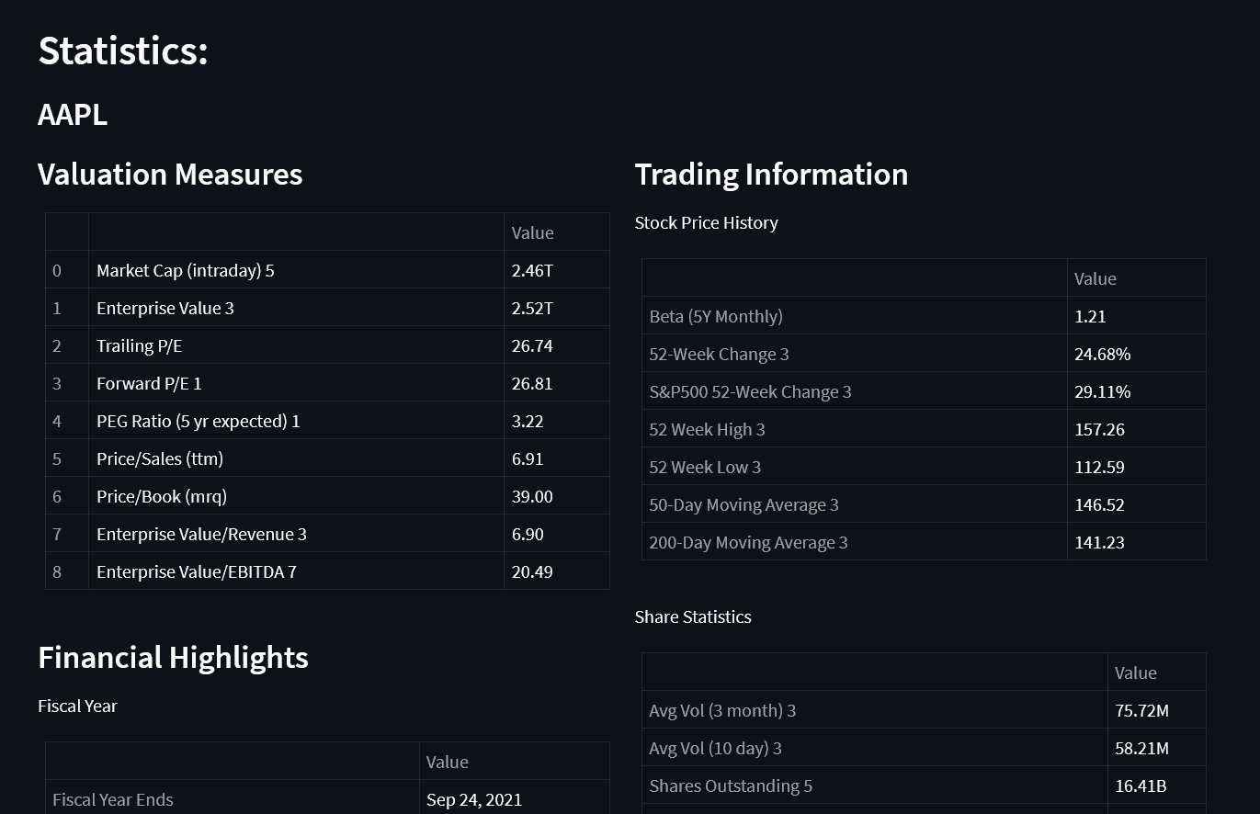
SIDEBAR
This tab shows a Statistics Summary of the selected ticker with:
Valuation Measure
Trading Information
Financial Highlights

Slide 6
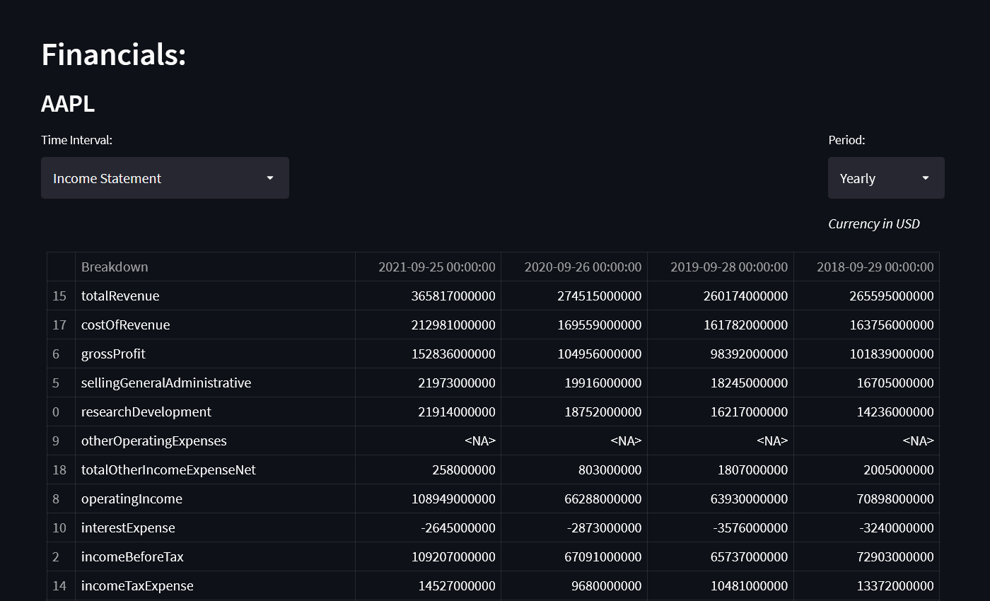
SIDEBAR
This tab shows the Financial statements of the selected ticker:
Income Statement
Balance Sheet
Cash Flow
You can select the period expressed :
Yearly
Quarterly

Slide 7
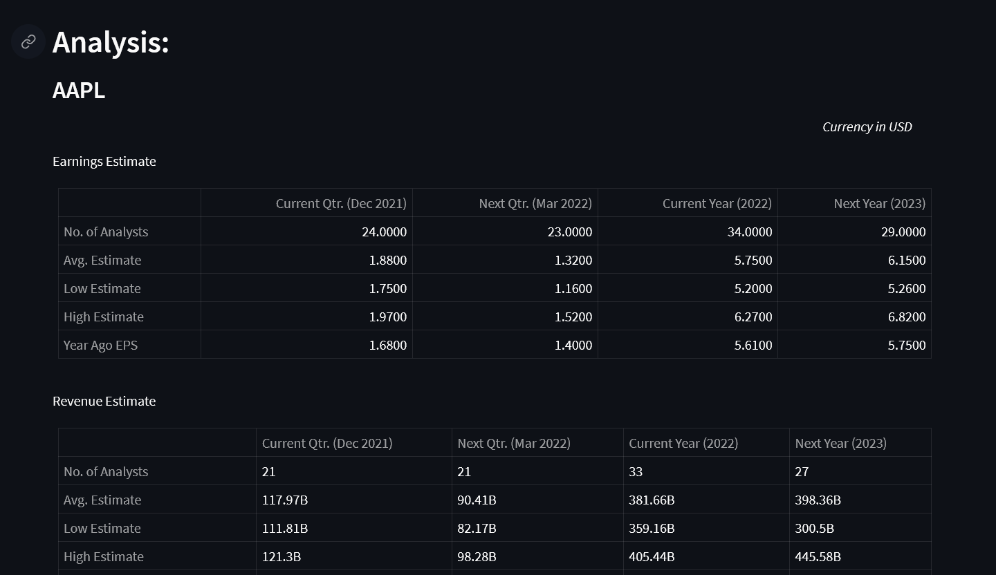
SIDEBAR
This tab shows a general analysis including:
Earnings Estimate
Revenue Estimate
Earnings History
EPS Trend
EPS Revisions
Growth Estimates

Slide 8
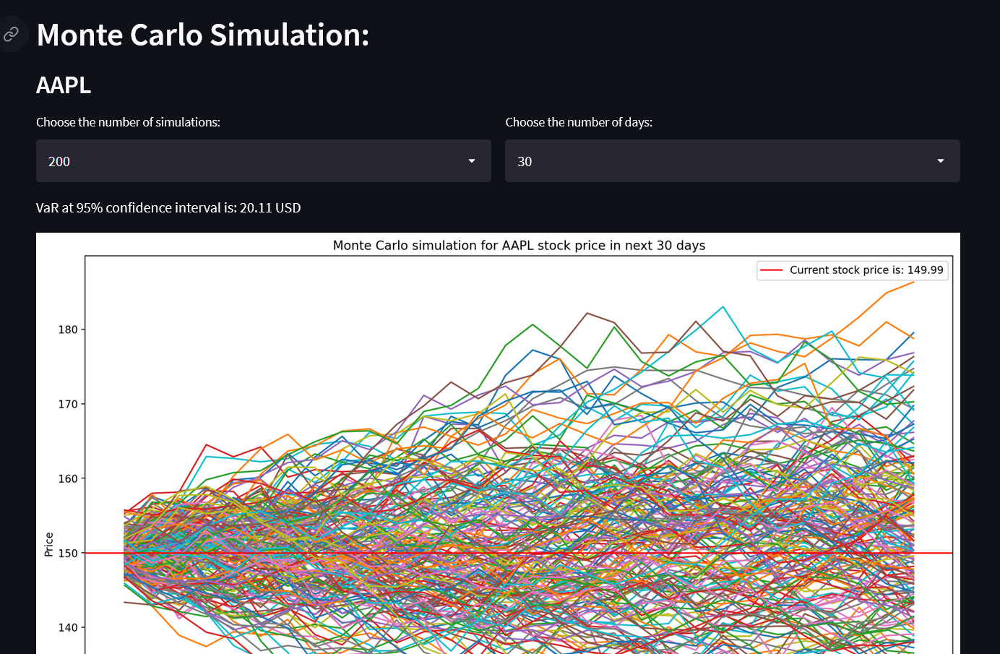
SIDEBAR
This tab shows a MonteCarlo Simulation of the Price of the selected ticker. You can choose the number of simulations and the number of days as shown here:

Slide 9
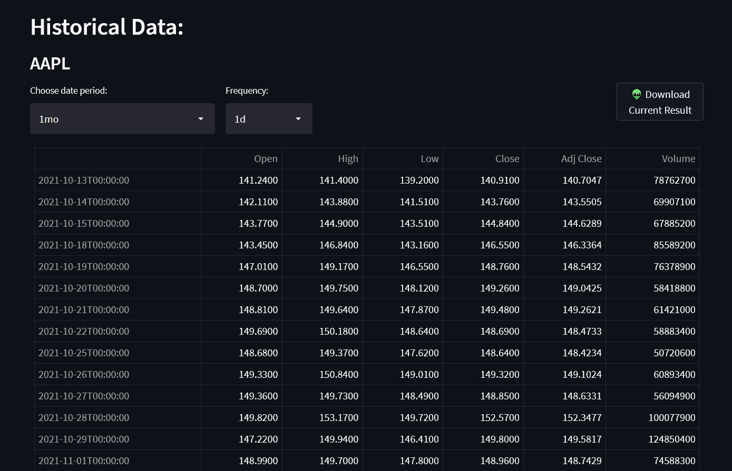
SIDEBAR
Finally, as an extra tab you can visualize the Historical Data of the selected ticker. You can choose the period and frequencyy(Interval).
Additionally, you can download the current result to an excel file.

